Slide 1
Python for Machine Learning at TACC
Amit Gupta
Data Mining & Statistics
Texas Advanced Computing Center
University of Texas at Austin
April 16th, 2019

Slide 2
Slides
https://cutt.ly/2eJNUI

Slide 3
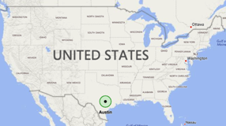
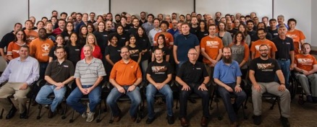
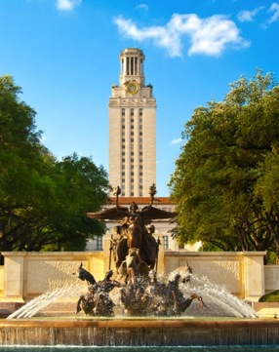

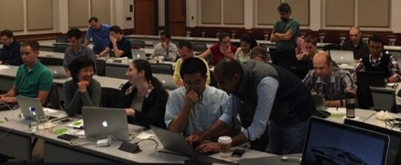
TACC AT A GLANCE
Personnel
150 Staff (~70 PhD)
Facilities
12 MW Data center capacity
Two office buildings, Three Datacenters, two visualization facilities, and a chilling plant.
Systems and Services
A Billion compute hours per year
5 Billion files, 50 Petabytes of Data, Hundreds of Public Datasets
Capacity & Services
HPC, HTC, Visualization, Large scale data storage, Cloud computing
Consulting, Curation and analysis, Code optimization, Portals and Gateways, Web service APIs, Training and Outreach

Slide 4
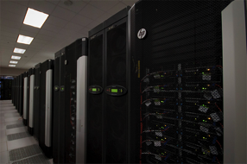
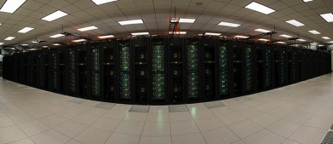




Slide 5
High Performance Computing and Machine Learning
Stampede 2 – 18 Pflops for simulation and modeling
Mixture of Xeon and Xeon Phi systems
Larger per node memory footprint
Maverick2 – GPU Enabled system
GTX - 23 Nodes, 4x Nvidia 1080 TI GPUs per node
V100 - 4 Nodes, 2x Nvidia V100 GPUs per node
P100 – 3 Nodes, 2x Nvidia P100 GPUs per node
Machine Learning system optimized for GPU (Tensorflow, Caffe)
Wrangler – 96 nodes cluster
Hadoop based for data intensive computing
10PB disk based Lustre file system
Flash storage system

Slide 7

FRONTERA
Coming soon in 2019
Aimed at the largest problems scientists and engineers currently face
TACC will Support and operate this system for 5 years.
Plan a potential phase 2 system, with 10x the capabilities, for the future challenges scientists will face.

Slide 8
FRONTERA - Hardware
Primary compute system: DellEMC and Intel
35-40 PetaFlops Peak Performance (Next Generation Xeon processors)
Interconnect: Mellanox HDR and HDR-100 links.
Fat Tree topology, 200Gb/s links between switches.
Storage: DataDirect Networks
50+ PB disk, 3PB of Flash, 1.5TB/sec peak I/O rate.
Single Precision Compute Subsystem: Nvidia
Front end for data movers, workflow, API

Slide 9











Data Analysis Support at TACC

Slide 10
Agenda
What is Python?
Overview
Uses
Accessing Python on TACC Machines
Jupyter Notebook
Python Language Basics
Python Customization on TACC Systems
Installing Modules/Packages locally

Slide 11
Python
Easy to learn & use
Ubiquitous, Great for quick prototyping
Supports various programming styles
Procedural, OO, Functional etc
Dynamically typed
A variable can be assigned to any data type
Strongly typed
Once assigned, it remains as that type
Documentation
https://docs.python.org

Slide 12
Python (2)
Modular Organization
Most of the utility comes from third party modules/libraries
Examples:
MatplotLib – Plotting and Visualization
Scikit-Learn – Machine Learning
Error Handing
Try , Except
Machine Learning
Data Cleaning and Preparation
Versions
Python 2.7 - Legacy, More mature Libraries
https://pythonclock.org/ (Retires Jan 1st, 2020)
Python 3 - Future, New Language Features

Slide 13
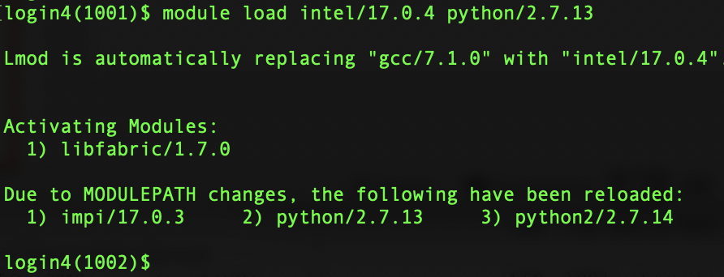
Accessing Python
Command Line (Interactive Prompt)
SSH into Wrangler/TACC Machine
Run ”ssh username@stampede2.tacc.utexas.edu ”
2 factor authentication (TACC Token App)
Load the python module
Run “module spider python/2.7.13
Run “module load intel/17.0.4 python/2.7.13

Slide 14
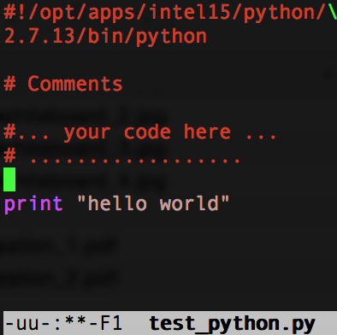
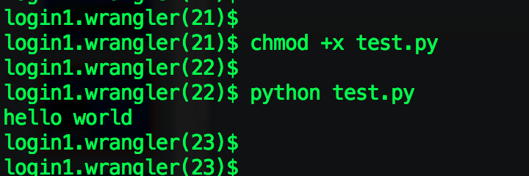
Accessing Python
Command Line, Python Script
Write a script in a text file and run
“which python” gives path to interpreter
Be sure to give your script execute permissions

Slide 15

Development Environment
Jupyter Notebook
http://jupyter.org/
Fork off the IPython
More fully featured Python shell
Requires a Python installation
Can be installed on your computer locally
python -m pip install --upgrade pip
python -m pip install jupyter
Provides an interactive interface in the browser
Can view output and plots inline
Makes Iterative/Interactive Development easy
Available on TACC machines
Wrangler
Stampede2

Slide 16
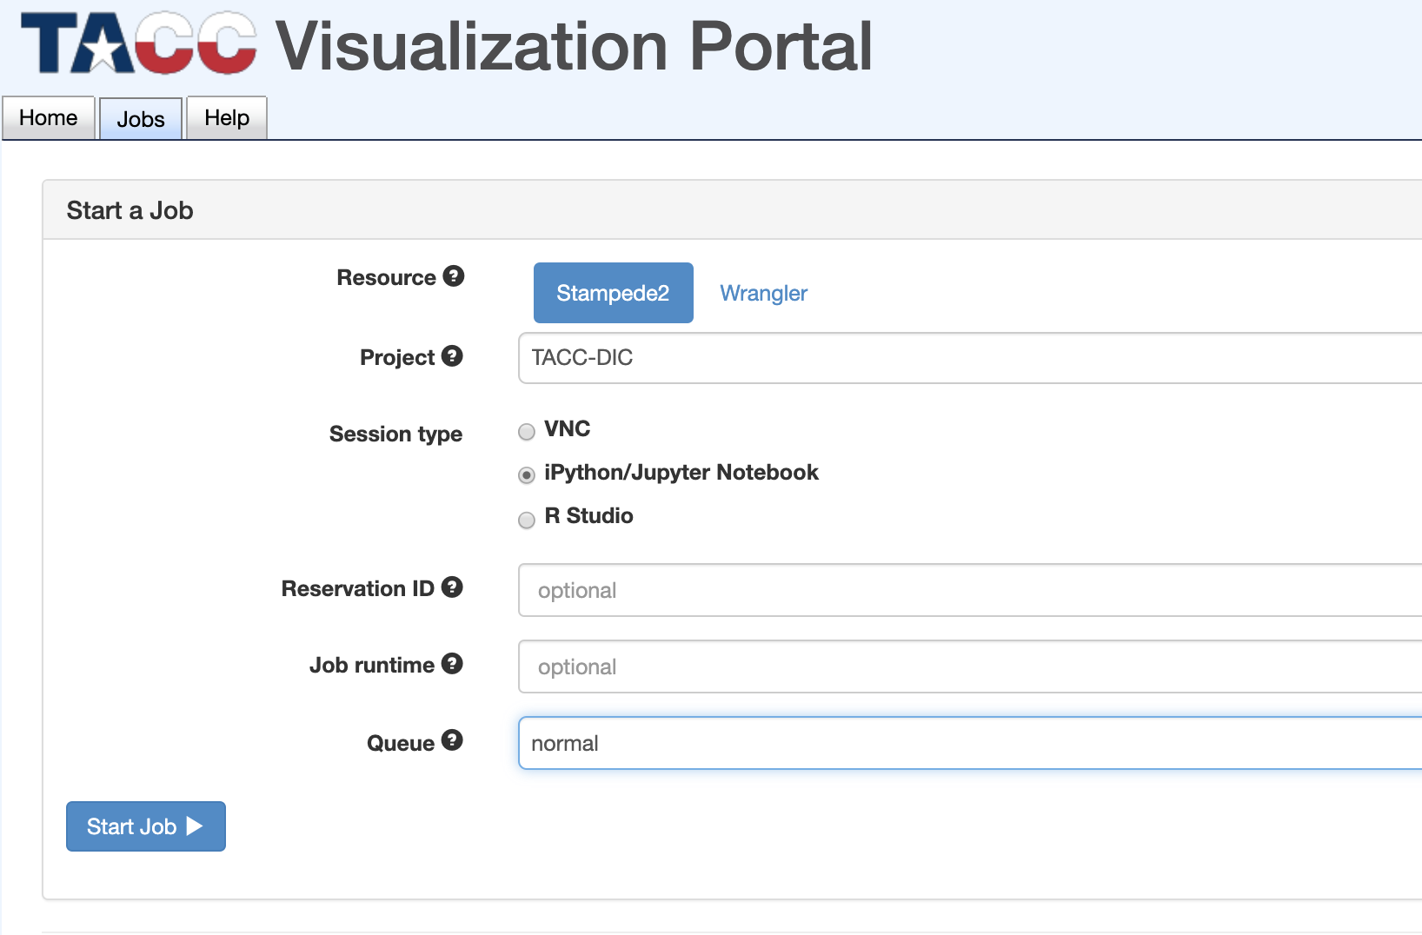
Accessing Python (3)
Jupyter Notebook via TACC VIS Portal
Log in https://vis.tacc.utexas.edu/ with your TACC/XSEDE account
TRAINING-OPEN or
TRAINING-HPC
ML
normal

Slide 17
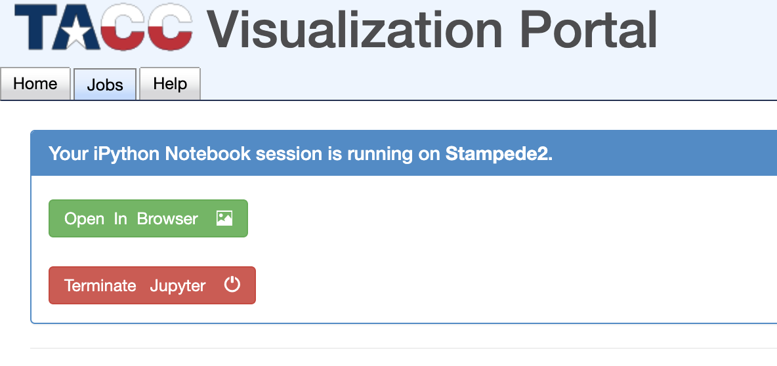
Accessing Python (4)

Slide 18
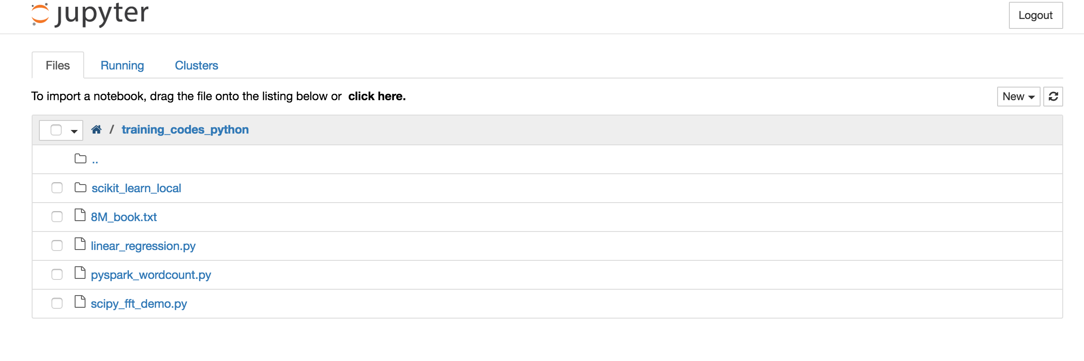
Accessing Python (5)
”New” -> Open IPython notebook

Slide 19
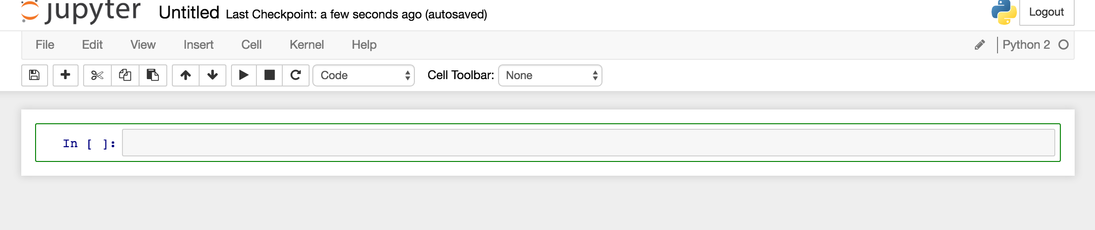
Ipython Notebook

Slide 20
Notebook Files
Or SSH into Stampede2 with your TACC credentials
On command prompt, type:
cp -rf /work/02679/agupta/stampede2/python_for_ML_training $HOME/
Will create folder “python_for_ML_training” in your home folder

Slide 21
Python Program Organization
Indentations matter
Code block boundaries (ex. if-else block, function block)
Modularization
Enables code reuse, importing functionality from other code
Every file can be a module
Code in separate folder with empty file “_ _ init _ _.py”
Modules can be combined to make packages
Packages => Module A => Module B => Module C
import Package.moduleA.moduleB.moduleC
“.” dot operator

Slide 22
Python Basics – Built-in Datatypes
Basic Types
int, float, long, complex, boolean
Strings
Collections
Dictionary
Key:Value pairs
List
Collection of objects (int, floats, any python object)
Tuple
Like lists, but unmutable
Everything is an object
Will have its own methods to manipulate it

Slide 23
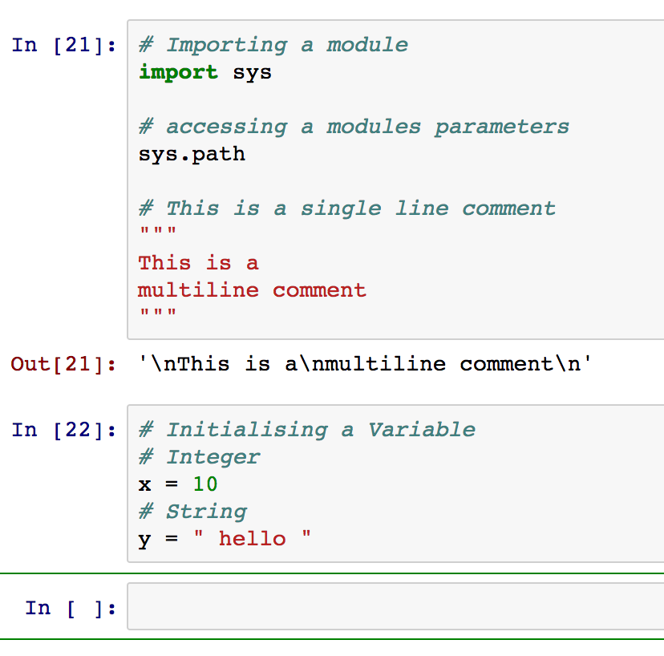
Python Basics – Example (1) python_for_ML_training / introduction / introduction.ipynb

Slide 24
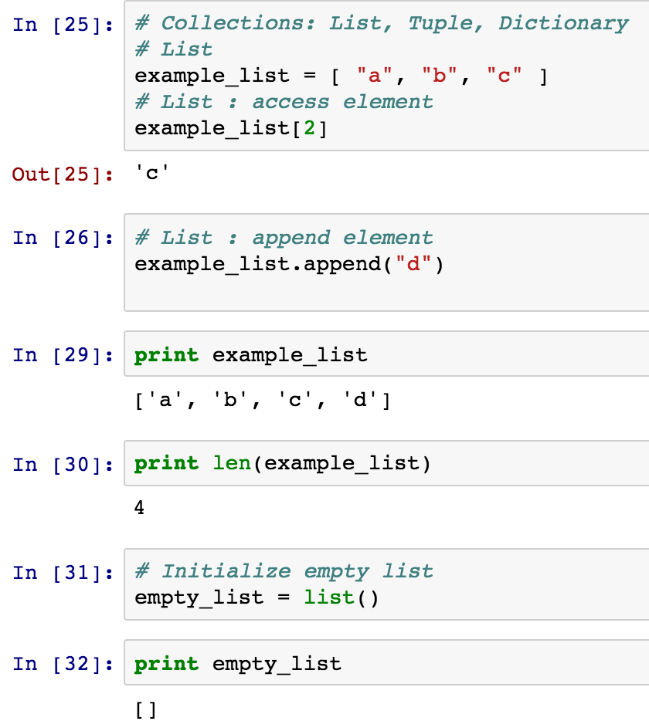
Python Basics – Example (2) introduction.ipynb

Slide 25
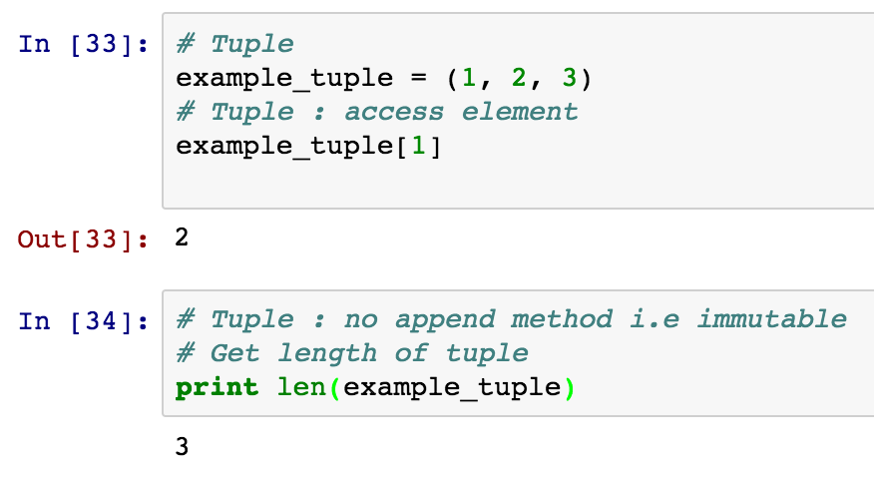
Python Basics – Example (3) introduction.ipynb

Slide 26
Python Basics – Control Flow
while:
while expression/boolean:
statements ….
….
for:
for x in ‘some iterable collection’:
statements …
break
Terminates loop
continue
Next iteration of loop
pass

Slide 27
Python Basics – Control Flow (2)
if-else
If condition:
statements….
else:
statements….
functions
def function_name(arguments):
statements …
try, except
try :
statements….
except exception-name:
statements….

Slide 28
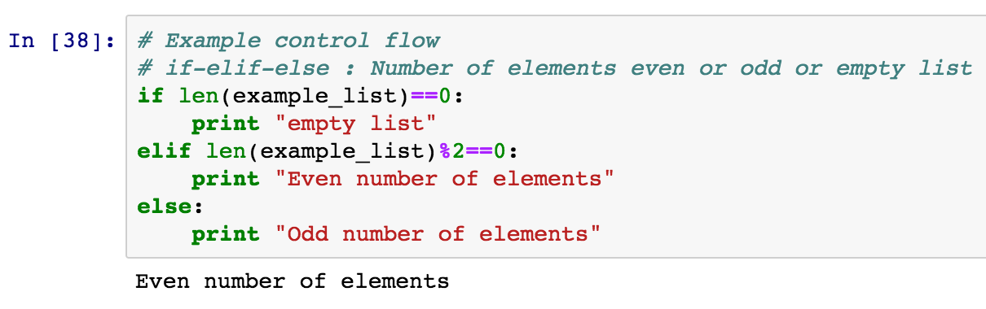
Python Basics – Control Flow (1) introduction.ipynb

Slide 29
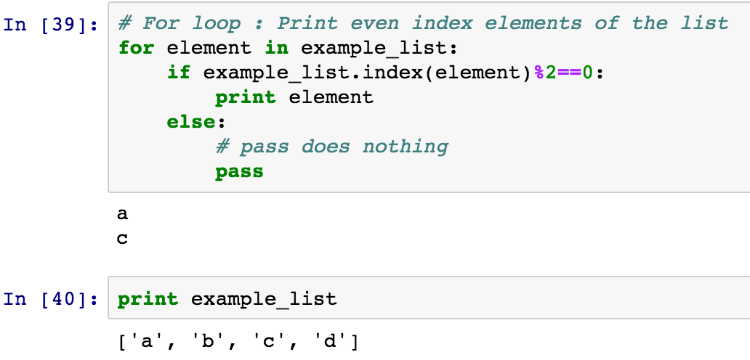
Python Basics – Control Flow (2) introduction.ipynb

Slide 30
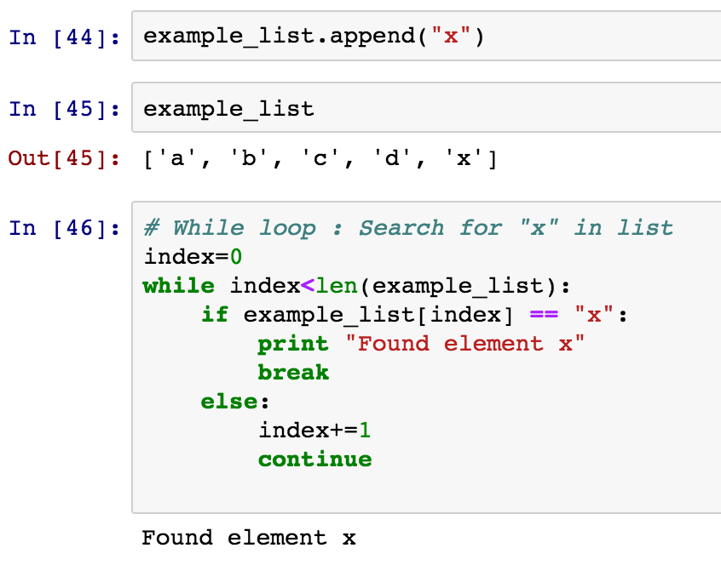
Python Basics – Control Flow (3) introduction.ipynb

Slide 31
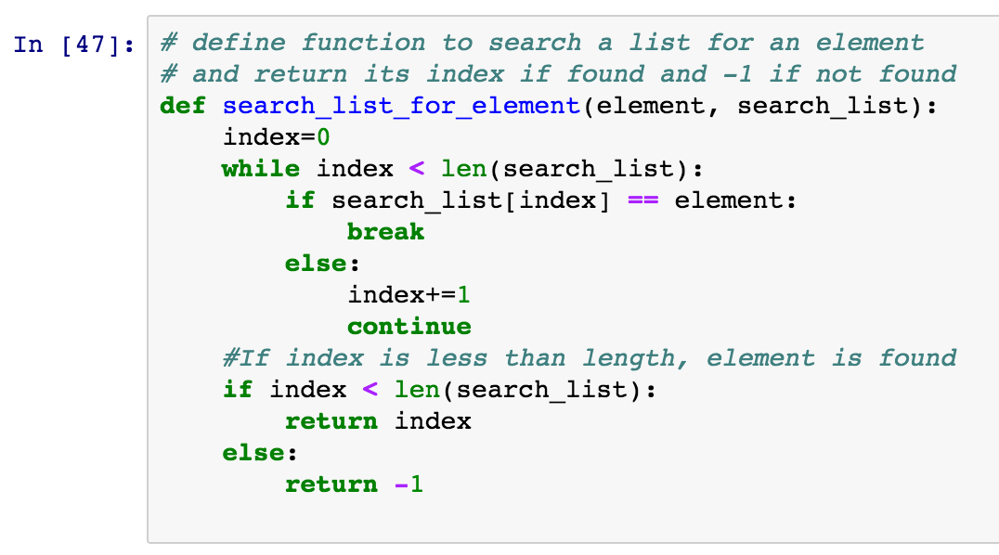
Python Basics – Control Flow (4) introduction.ipynb

Slide 32
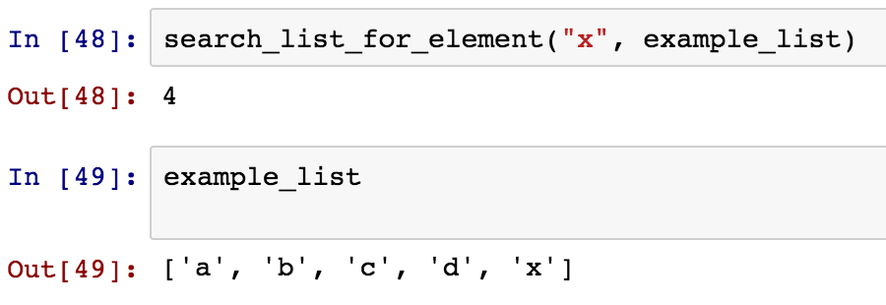
Python Basics – Control Flow (5) introduction.ipynb

Slide 33
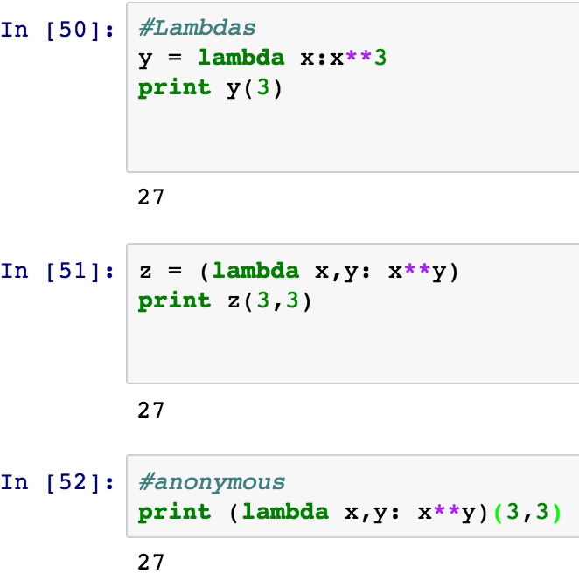
Lambda Functions
Functions on the fly
Small one-liner functions
Can be assigned to a variable, used as arguments
Or used directly

Slide 34
Exercise
Write a function to compute a vector dot product of 2 lists
Define a function dot(x,y) that accepts 2 lists as arguments
Check if length of both lists are equal using len() function
If they are not equal print a message and return
Generate the range of indices to iterate over
Return the value of the dot product
Test it
Define 2 lists a=[1,2,3,4,5] and b=[6,7,8,9,10]
Compute Dot Product with your function
Print result

Slide 35
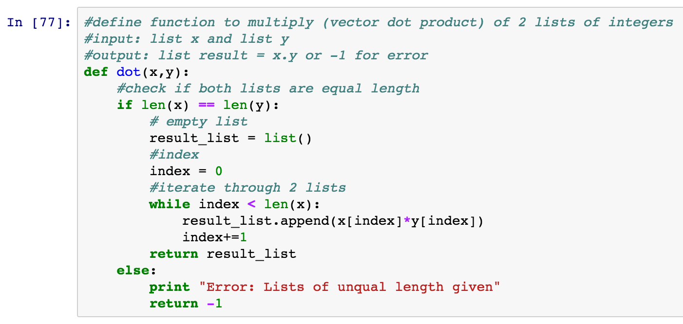
Exercise introduction.ipynb

Slide 36
Python Basic File I/O
Open a file
file_object = open(file_name [, access_mode][, buffering])
Access Mode : Read (r), Write (w), Append (a)
Buffering (Size of file buffer)
0==Unbuffered, 1==Line Buffered, >1==Size of buffer
Returns a file object
Use its methods to manipulate file

Slide 37
Python Basic File I/O
Read from a file
data_string = file_object.read(number_of_bytes_to_read)
Returns a string (even if file is binary)
Current position in the file
file_object.tell()
Read a line from file
line_string = file.object.readline()
Reads till trailing newline (“\n”) character.
Retains it in the string
Returns blank string for EOF

Slide 38
Python Basic File I/O
Write to a file
data_string = file_object.write(string_to_write)
Returns a string (even if file is binary)
Current position in the file
file_object.tell()
Close a file
file_object.close()

Slide 39
Exercise
Write a program to count the number of lines in a book (txt file provided: $HOME/python_for_ML_training/data/8M_book.txt).
Give a full path of the file to open()

Slide 40
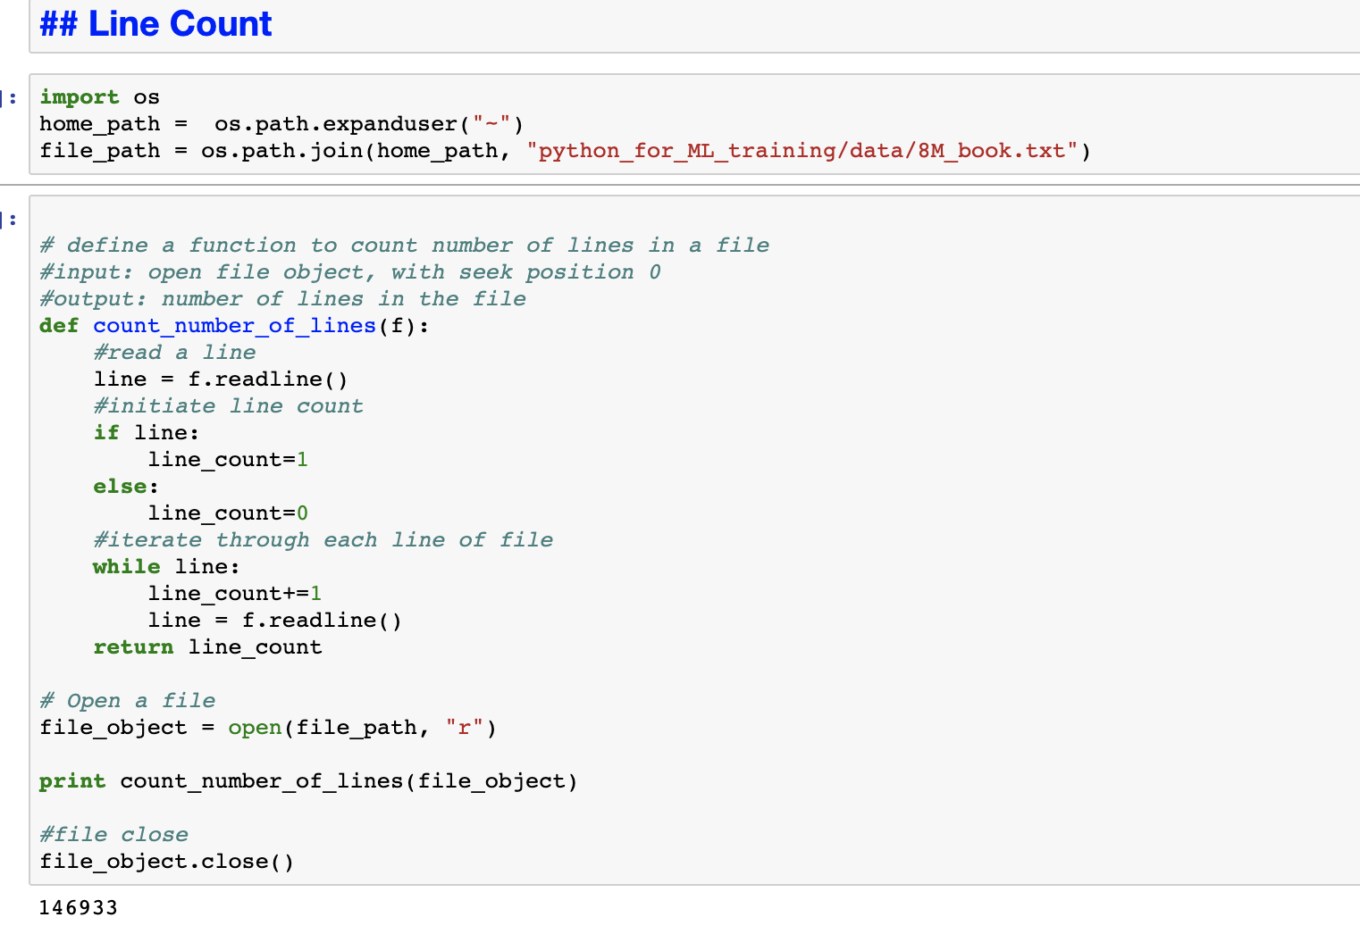
Exercise introduction.ipynb

Slide 41
Installing python modules
First on command line run
“module load python/2.7.13”
Python Package Index (pip)
Packages/Modules can be installed locally
No Root priviliges required
When searching for an available package
pip search package_name

Slide 42
Installing python modules
pip install --user package_name
Installs in the USER_BASE area
~/.local/ folder
To install in a folder you create
pip install <package_name> --install-option=“--prefix=<local install path>”
For modules from third party distributors
python setup.py install --user
python setup.py install --home=<dir>

Slide 43
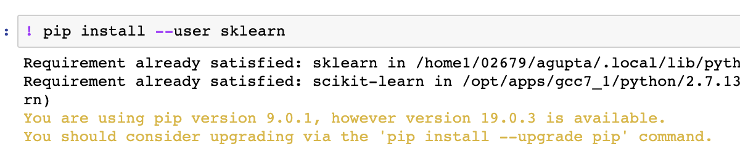
Installing python modules
Install SciKit Learn (sklearn)
Machine Learning for Python
Run PIP to install scikit-learn
pip install --user sklearn

Slide 44
Break
Resume at 2PM

Slide 45
Useful Packages for ML
NumPy
SciPy
Pandas
MatplotLib
Scikit-Learn

Slide 46
Numpy
Important package for Scientific Computing
N-dimensional array object
More efficient than python objects
Tools for integrating low level code (C/C++/Fortran)
Also has Mathematical Functions
Documentation
https://docs.scipy.org/doc/numpy/

Slide 47
Numpy
N-dimensional array
Fundamental part of Numpy Package
Container for Homogenous data
Contiguous in memory
Leads to faster operations
Collection manipulated like scalars

Slide 48
Numpy
Each Dimension is called an Axis
Shape
Size of array along each dimension
Tuple of axis sizes
Rank
Number of dimensions in array
Length of the Shape Tuple
1 | 16 | 35
10 | 45 | 33
9 | 8 | 23
64 | 90 | 87
Shape = (4,3)
Rank = 2

Slide 49
Numpy Array
Data Types available
int8, uint8
int16, uint16
int32, uint32
int64, uint64
float16
float32
float64
float128
complex
boolean
….

Slide 50
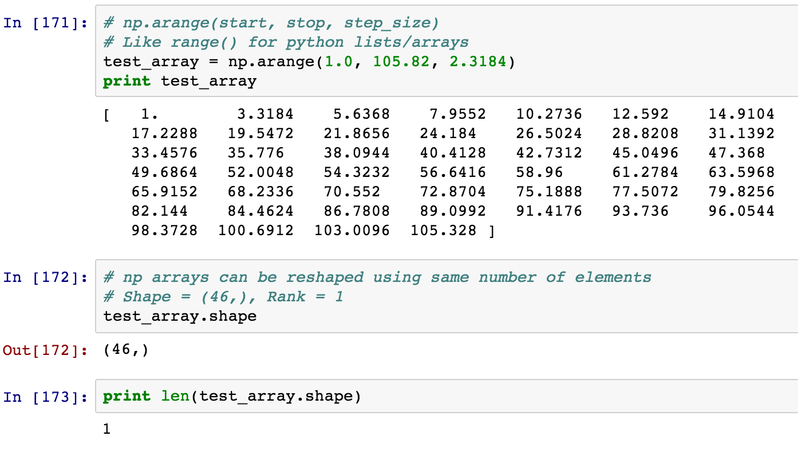
Numpy Array python_for_ML_training / unsupervised / numpy_examples.ipynb

Slide 51
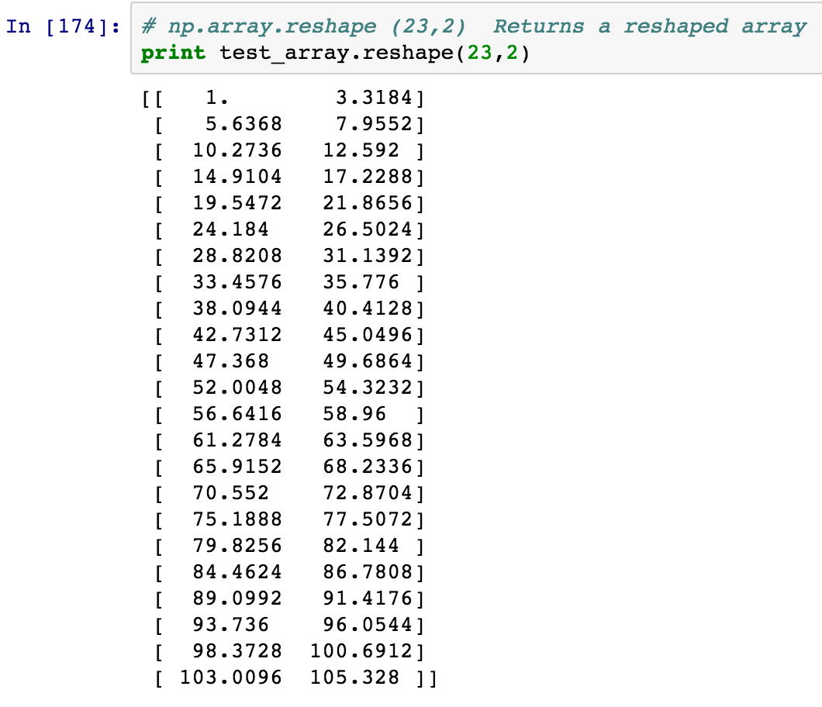
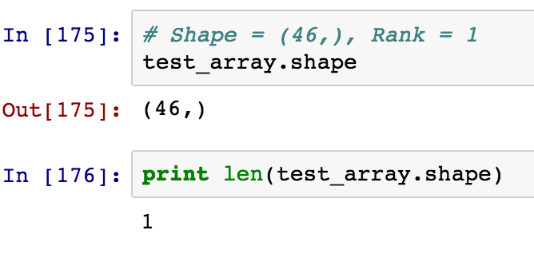
Numpy Array numpy_examples.ipynb

Slide 52
Numpy Array Slicing numpy_examples.ipynb
test_array
1 | 2 | 3 | 4 | 5 | 6 | 7
3 | 6 | 9 | 12 | 15 | 18 | 21
5 | 10 | 15 | 20 | 25 | 30 | 35
7 | 14 | 21 | 28 | 35 | 42 | 49

Slide 53
Numpy Array Slicing numpy_examples.ipynb
test_array[2]
0 | 1 | 2 | 3 | 4 | 5 | 6
0
1
2
3
1 | 2 | 3 | 4 | 5 | 6 | 7
3 | 6 | 9 | 12 | 15 | 18 | 21
5 | 10 | 15 | 20 | 25 | 30 | 35
7 | 14 | 21 | 28 | 35 | 42 | 49

Slide 54
Numpy Array Slicing numpy_examples.ipynb
test_array[1:3]
0 | 1 | 2 | 3 | 4 | 5 | 6
0
1
2
3
1 | 2 | 3 | 4 | 5 | 6 | 7
3 | 6 | 9 | 12 | 15 | 18 | 21
5 | 10 | 15 | 20 | 25 | 30 | 35
7 | 14 | 21 | 28 | 35 | 42 | 49

Slide 55
Numpy Array Slicing numpy_examples.ipynb
test_array[2,5]
0 | 1 | 2 | 3 | 4 | 5 | 6
0
1
2
3
1 | 2 | 3 | 4 | 5 | 6 | 7
3 | 6 | 9 | 12 | 15 | 18 | 21
5 | 10 | 15 | 20 | 25 | 30 | 35
7 | 14 | 21 | 28 | 35 | 42 | 49

Slide 56
Numpy Array Slicing numpy_examples.ipynb
test_array[1:3, 2:5]
0 | 1 | 2 | 3 | 4 | 5 | 6
0
1
2
3
1 | 2 | 3 | 4 | 5 | 6 | 7
3 | 6 | 9 | 12 | 15 | 18 | 21
5 | 10 | 15 | 20 | 25 | 30 | 35
7 | 14 | 21 | 28 | 35 | 42 | 49

Slide 57
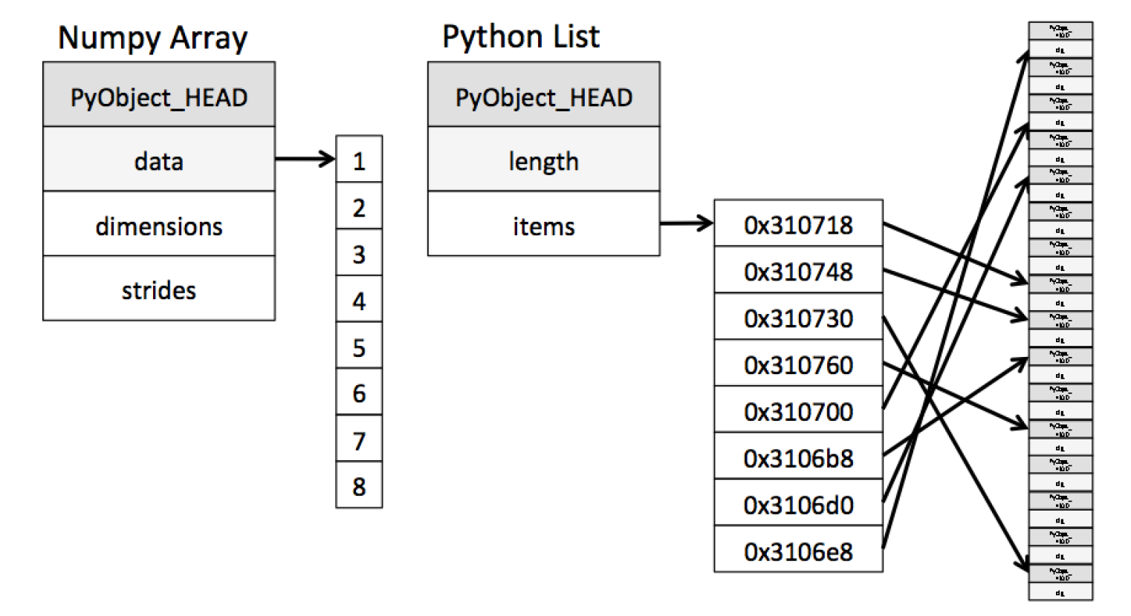
Numpy

Slide 58
Numpy - ufunc
Universal functions
Part of the np.”namespace”
np.sqrt(array)
Operate on ndarrays element-by-element
Builtin functions, implemented in C
Low level close to hardware
Efficient
Vectorized versions of their python counterparts

Slide 59
Numpy - ufunc
np.arange(number)
np.dot(array, array)
np.sqrt(array)
np.sort(array)
np.mean(array)
np.random.randn(x, y, z…)
…

Slide 60
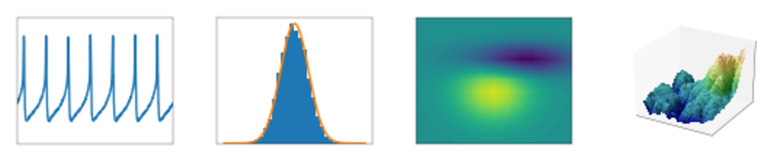
Matplotlib
Mature plotting library for Python
https://matplotlib.org/
Many options plots, coloring and visualizations
Demo codes

Slide 61
Matplotlib
In notebook
%matplotlib inline
Scatter plot
Line plot
Histogram/Bar Plot
3D Plot

Slide 62
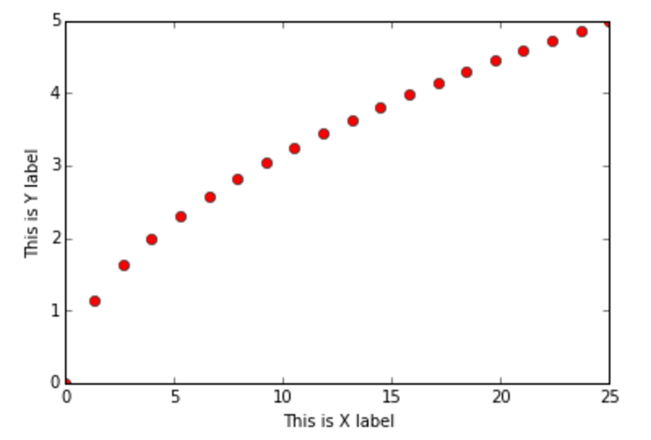
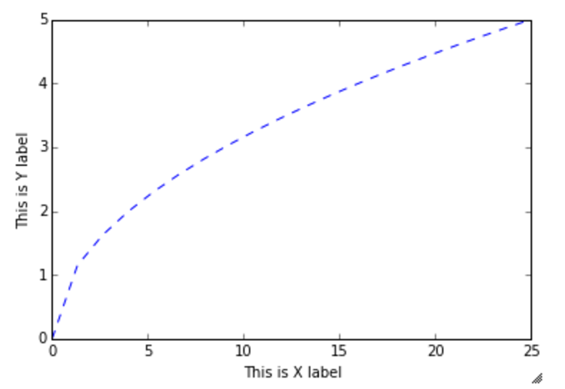
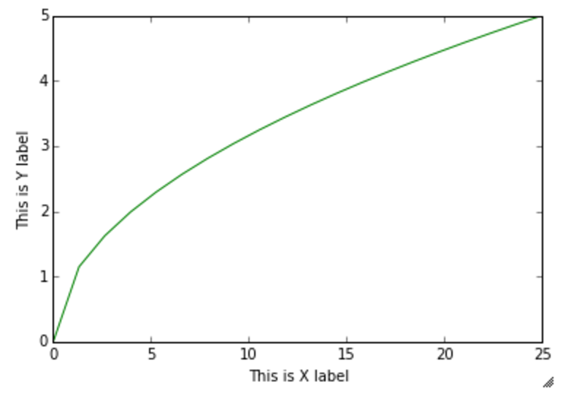
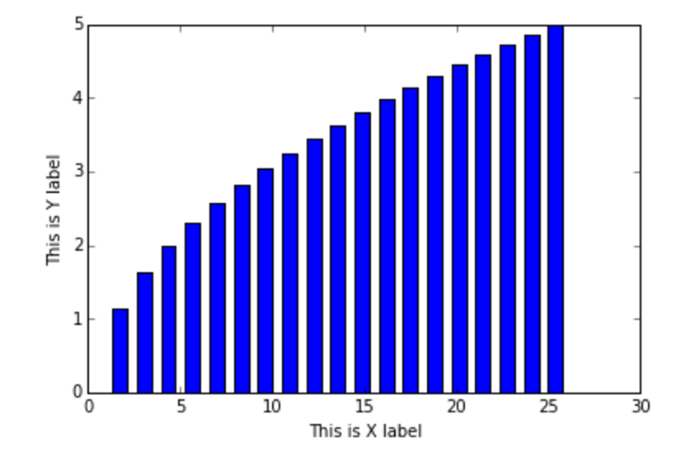
Matplotlib matplotlib_examples.ipynb

Slide 63
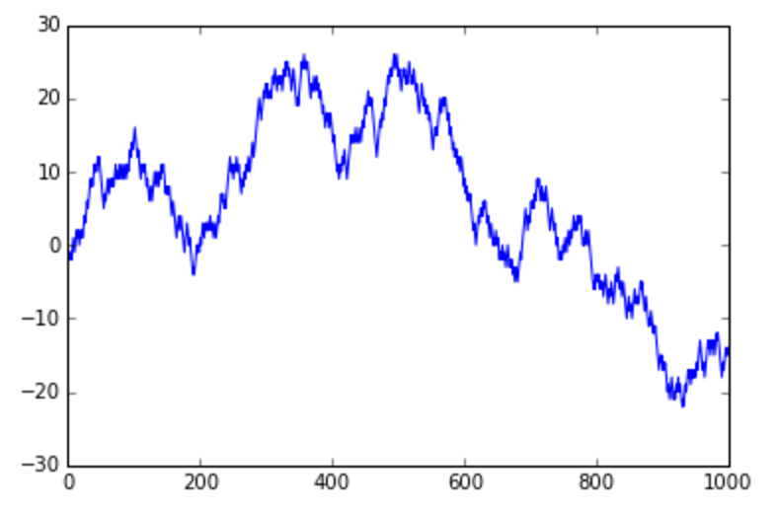
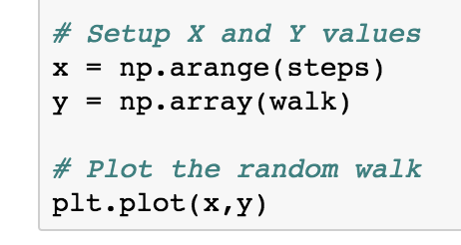
Example – Random Walking matplotlib_examples.ipynb

Slide 64
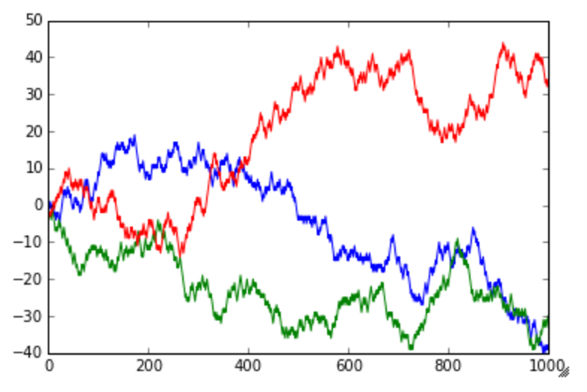
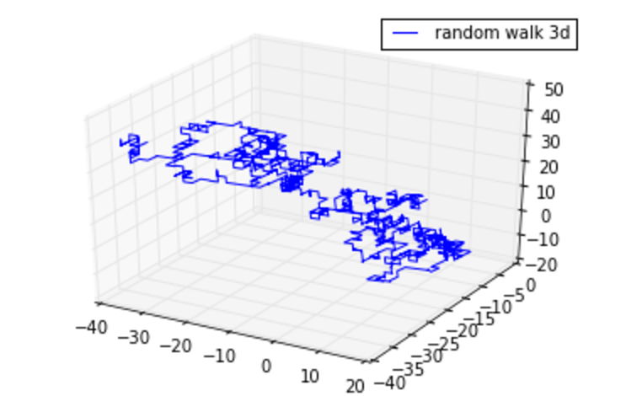
Example – 3D Random Walking matplotlib_examples.ipynb

Slide 65
SciPy
Python package dedicated to scientific computing
Module each for specialized areas
special functions, statistics, optimization etc.
Builds upon NumPy
To import from package
from scipy import sub-module-name

Slide 66
SciPy
Special Functions
Integration
Optimization
Interpolation
Fourier Transforms
Signal Processing
Linear Algebra
Statistics

Slide 67
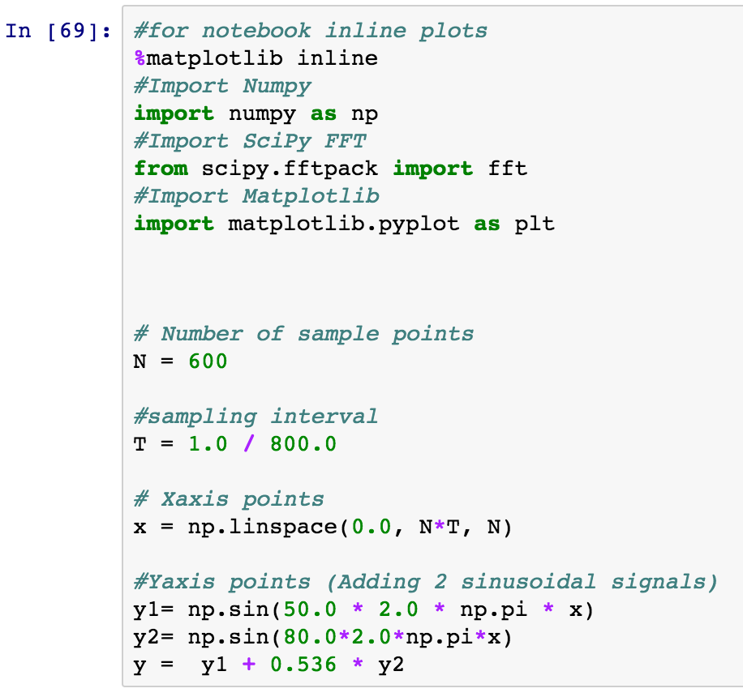
SciPy scipy_fft_demo.ipynb

Slide 68
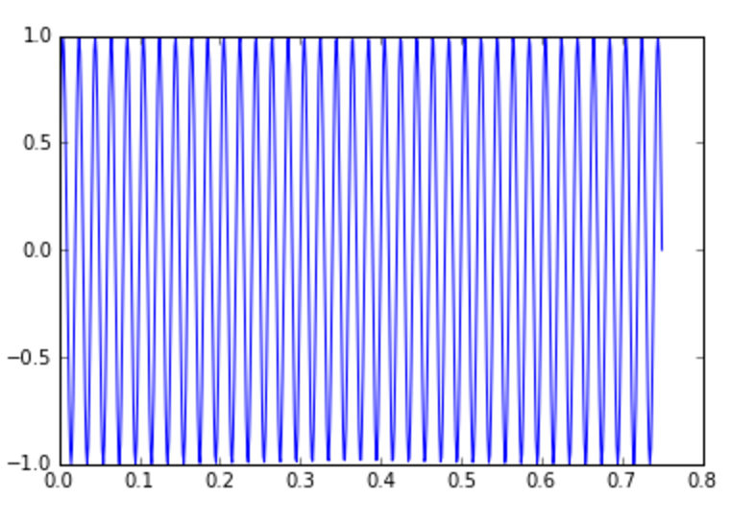
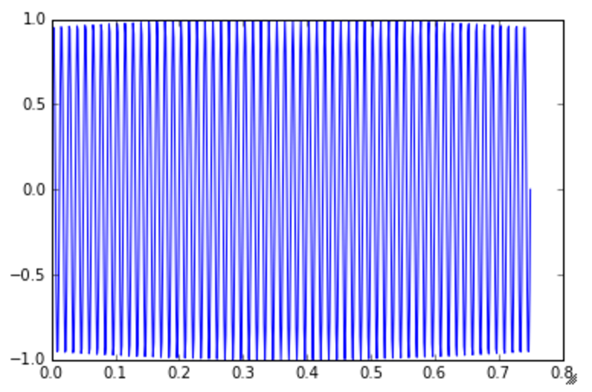
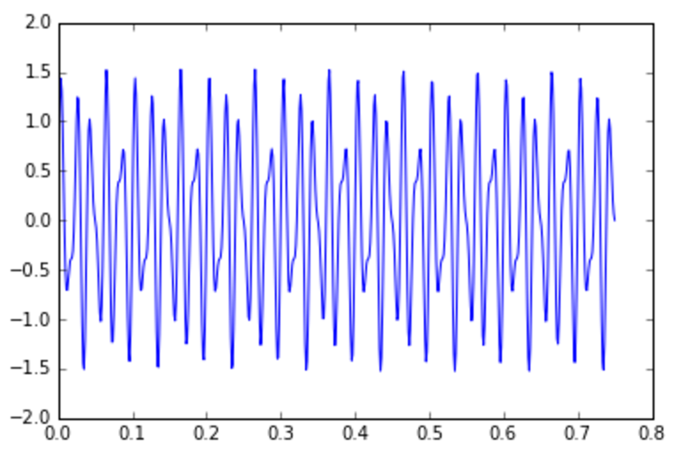
SciPy scipy_fft_demo.ipynb
+
=

Slide 69
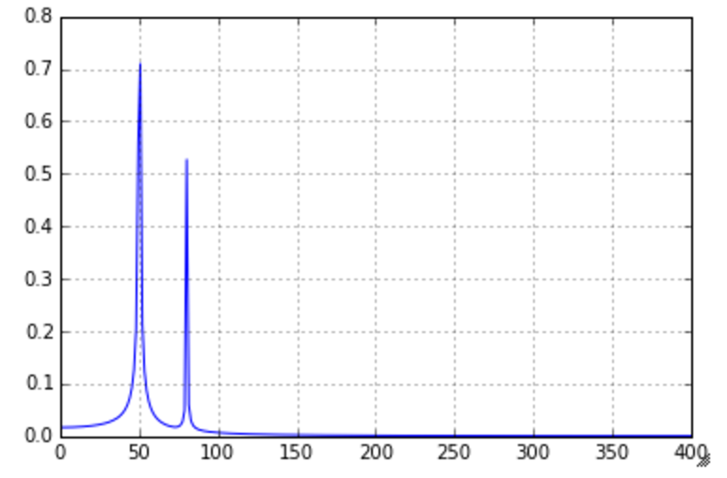
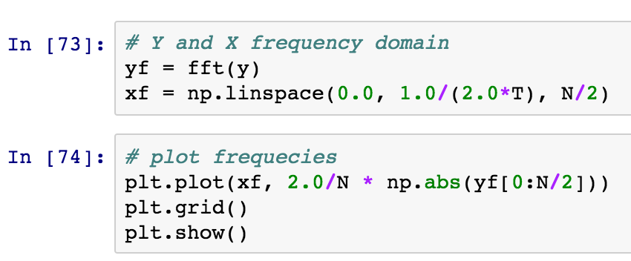
SciPy scipy_fft_demo.ipynb

Slide 70
Pandas
Python package that builds upon numpy arrays
Useful in data analysis
Common manipulations of arrays
Series
Useful for sequence data like time-series
DataFrame
Useful for spreadsheet like data
Analogous to R Data Frames
Documentation
http://pandas.pydata.org/

Slide 71
Pandas(2)
Supports various file formats
CSV
HDF5
Excel Files
JSON
XML
PICKLE
Graceful handling of missing values
Has internal plotting functions
Has many powerful functions
Database style joins

Slide 72
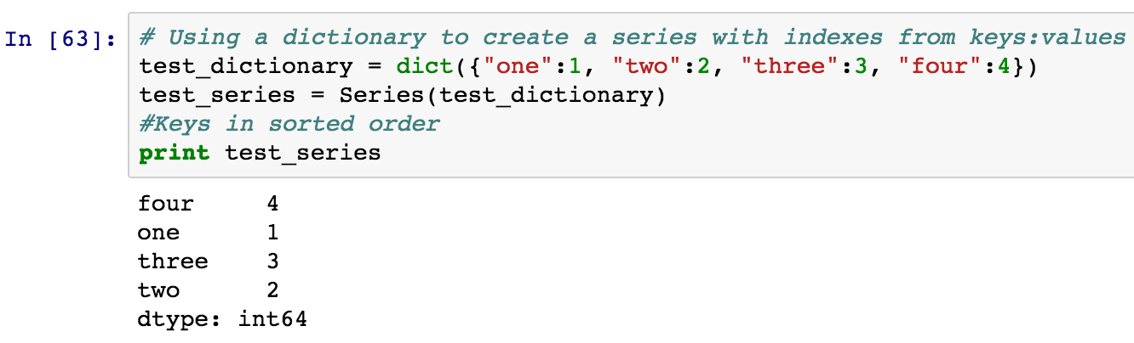
Series pandas_examples.ipynb

Slide 73
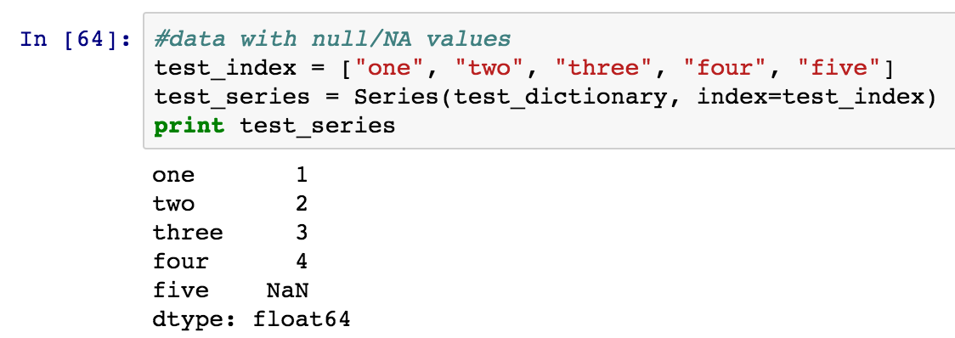
Series pandas_examples.ipynb

Slide 74
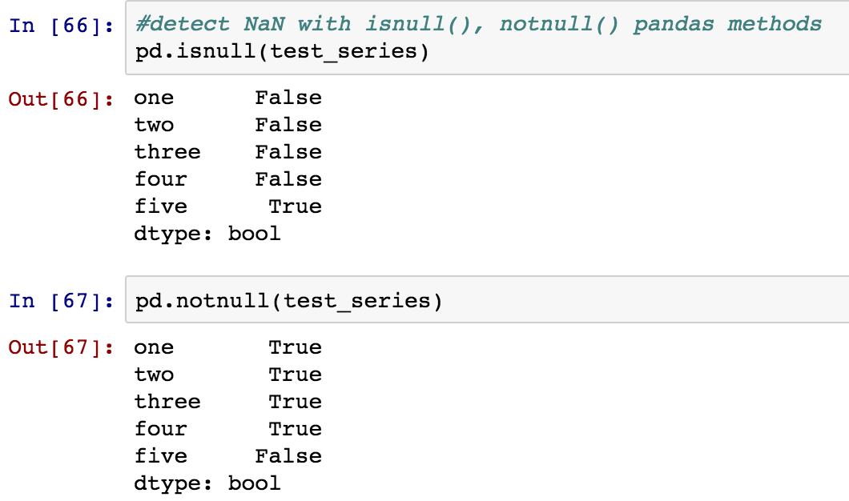
Series pandas_examples.ipynb

Slide 75
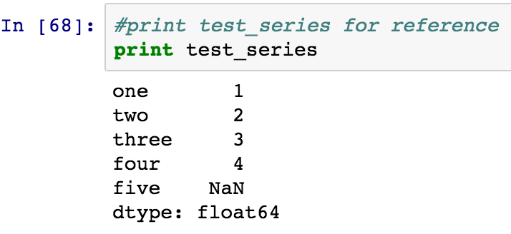
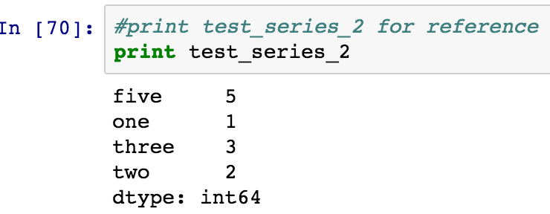
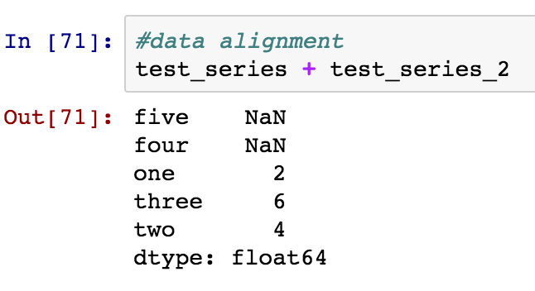
Series pandas_examples.ipynb

Slide 76

Data Frame pandas_examples.ipynb

Slide 77

Data Frame pandas_examples.ipynb

Slide 78

Data Frame pandas_examples.ipynb

Slide 79

Data Frame pandas_examples.ipynb

Slide 80

Data Frame pandas_examples.ipynb

Slide 81

Data Frame pandas_examples.ipynb

Slide 82

Data Frame pandas_examples.ipynb

Slide 83


Data Frame pandas_examples.ipynb

Slide 84


Data Frame pandas_examples.ipynb

Slide 85

Data Frame pandas_examples.ipynb

Slide 86




Data Frame Join

Slide 87
Scikit-Learn
Machine Learning package
Good Documentation
Example Codes
Common Machine Learning Methods
Regression
Predicting Value
Classification
Assigning predefined Class/Groups
Clustering
Learning Groups
Dimensionality Reduction
Simplifying (by reducing features)

Slide 88
Scikit-Learn
Machine Learning library for Python community
Built upon NumPy, SciPy and Matplotlib
Comes with some standard datasets
Supervised and Unsupervised Learning
Documentation with numerous examples
http://scikit-learn.org

Slide 89
Dataset
Boston Housing Dataset
Included in Sklearn
sklearn.datasets.load_boston()
506 samples (rows)
13 features
CRIME RATE
Pupil-Teacher Ratio
TAX
PRICE
AGE
…

Slide 90
Dataset
CRIM - per capita crime rate by town
ZN - proportion of residential land zoned for lots over 25,000 sq.ft.
INDUS - proportion of non-retail business acres per town
CHAS - Charles River dummy variable (= 1 if tract bounds river; 0 otherwise)
NOX - nitric oxides concentration (parts per 10 million)
RM - average number of rooms per dwelling
AGE - proportion of owner-occupied units built prior to 1940
DIS - weighted distances to five Boston employment centres
RAD - index of accessibility to radial highways
TAX - full-value property-tax rate per $10,000
PTRATIO pupil-teacher ratio by town
B - 1000(Bk - 0.63)^2 where Bk is the proportion of blacks by town
LSTAT - % lower status of the population
MEDV - Median value of owner-occupied homes in $1000’s
PRICE – Property Price

Slide 91

Dataset

Slide 92

Kmeans Clustering
Unsupervised Learning Algorithm
No Training/Testing data split

Slide 93
Kmeans Clustering
Start:
Number of clusters to find
starting points as “center” for each cluser
Calculate mean distance for each “center” point
Divides into clusters based on nearest mean
Centroid of each cluster becomes the new “center” point
Repeat till convergence

Slide 94


Kmeans Clustering
cluster.kmeans() expects arguments in dimension :
argument[number of samples*number of features]

Slide 95

Kmeans Clustering

Slide 96
Kmeans Clustering
Unlabeled data
Some intuition of number of groups
Domain knowledge of the dataset
No training needed
Doesn’t work under certain conditions
Sparse clusters/ Overlapping clusters
Clusters of different sizes
Clusters in feature space (Dependent features)
Can get stuck in local minima
Kmeans++

Slide 97
Break
Resume at 3PM
Exercise:
Run kmeans on the IRIS Flower dataset:
Code at:
https://scikit-learn.org/stable/auto_examples/cluster/plot_cluster_iris.html

Slide 98
Supervised Learning
Linear Regression
Support Vector Machines (SVM)
Naïve Bayes Classifier

Slide 99


Linear Regression

Slide 100


Linear Regression python_for_ML_training / supervised / supervised.ipynb

Slide 101

Linear Regression supervised.ipynb

Slide 102


Linear Regression supervised.ipynb

Slide 103
Linear Regression supervised.ipynb
Underlying relationship should be linear
Only one Target variable
many covariates/independent variables ➔ One Target
Assumes independent covariates
Not suitable
Non Linear relationships
Oversimplification
Higher MSE
Many Targets
Dependency in Covariates

Slide 104
Support Vector Machine
Given a few sets of labeled training data
supervised learning
Generate an optimal hyperplane
Categorizes new examples.
Notes:
辨别式分类器（Discriminative classifier）

Slide 105
Binary Classification with Linear Separator
Red and blue dots are representations of objects from two classes in the training data
The line is a linear separator for the two classes
The closets objects to the hyperplane is the support vectors
ρ
Notes:
lines and points in the Cartesian plane

Slide 106
Binary Classification with Linear Separator
Find a line passing as far as possible fro both points
The optimal separating hyperplane maximizes the margin of the training data.
A line is bad if it passes too close to some points (noise sensitive)
ρ
Notes:
points because it will be noise sensitive and it will not generalize correctly.

Slide 107
Linear Support Vector Machine
Sec. 15.1
Hyperplane
w^{T} x + b = 0
w^{T}(x_{a}–x_{b}) = 2
ρ = ||x_{a}–x_{b}||₂ = 2/||w||₂
Maximize the margin ρ,
Minimize ||w||
ρ
w^{T}x_{a} + b = 1
w^{T}x_{b} + b = -1
w^{T} x + b = 0

Slide 108
Dataset
Wisconsin Breast Cancer Dataset
Available within sklearn.datasets
569 Samples
30 Features: From cancer diagnostic imaging
Area
Mean Radius
Perimeter
….

Slide 109


Slide 110

Naïve Bayes Classification
Bayes Rule
$$P\left(c_{i} | x_{0},…{,x}_{n}\right)=\frac{P\left(x_{0},…{,x}_{n} | c_{i}\right)∗P\left(c_{i}\right)}{P\left(x_{0},…,x_{n}\right)}$$
$$P\left(c_{i} | x_{0},…{,x}_{n}\right)∝\frac{P\left(x_{0},…{,x}_{n} | c_{i}\right)∗P\left(c_{i}\right)}{Const}$$
$$P\left(c_{i} | x_{0},…{,x}_{n}\right)∝P\left(x_{0},…{,x}_{n} | c_{i}\right)∗P\left(c_{i}\right)$$

Slide 111

Naïve Bayes Classification
Assuming all features are independent (“ Naïve ”)
$P\left(x_{0},…,x_{n} | c_{i}\right)=∏P\left(x_{0} | c_{i}\right)$
$$P\left(c_{i} | x_{0},…{,x}_{n}\right)∝P\left(x_{0},…{,x}_{n} | c_{i}\right)∗P\left(c_{i}\right)$$
$$P\left(c_{i} | x_{0},…{,x}_{n}\right)∝P\left(c_{i}\right) ∗ (∏P\left(x_{0} | c_{i}\right))$$
From Data From Feature Distribution
Therefore
$$y=argmax(P\left(c_{i}\right) ∗ (∏P\left(x_{0} | c_{i}\right))$$

Slide 112


Naïve Bayes Classification

Slide 113


Naïve Bayes Classification

Slide 114
Naïve Bayes Classification
Assumes independent features
Simplifies calculation
Fast computation
Even in higher dimensions
Works well in most cases
Assumptions on the distribution of feature vectors can be changed
For text data, Multinomial distribution
Most of the time, Normal (Gaussian) distribution

Slide 115
TACC Training Offerings
TACC Institute Series
https://www.tacc.utexas.edu/education/institutes
Data Analysis
Visualization
HPC
Sys Admin
Life Sciences
Data Institute
Deep Learning (Caffe, Tensorflow, MXNet, Horovod)
Machine Learning Methods
Hadoop & Spark (Scala)
Data Analytics with
R
Python

Slide 116
References
Dive Into Python
http://www.diveintopython.net/
Official Python Documentation
https://docs.python.org
Numpy & SciPy
https://docs.scipy.org/doc/
www.numpy.org
SciKit-Learn
http://scikit-learn.org/
Always cross check Documentation and Tool/Library/Framework versions

Slide 117
Thanks
Questions
Contact: agupta@tacc.utexas.edu
Issues with Python @ TACC Systems
Open a ticket a http://consult.tacc.utexas.edu
Queue : DATA INTENSIVE COMPUTING

Slide 118

Kmeans Clustering sklearn_kmeans_example.ipynb

Slide 119


Kmeans Clustering sklearn_kmeans_example.ipynb

Slide 120

Kmeans Clustering sklearn_kmeans_example.ipynb

Slide 121

Kmeans Clustering sklearn_kmeans_example.ipynb

Slide 122

Kmeans Clustering sklearn_kmeans_example.ipynb

Slide 123

Kmeans Clustering sklearn_kmeans_example.ipynb

Slide 124

Kmeans Clustering sklearn_kmeans_example.ipynb

